Slide 1

UDP - Sockets
Dr. S.F.Rodd
Professor, Dept. of CSE, GIT

Slide 2
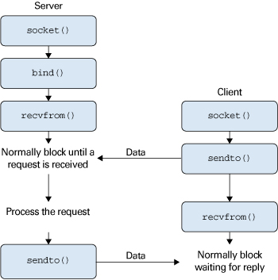
Sendto and Recivefrom function used in UDP

Slide 3
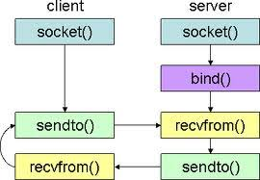
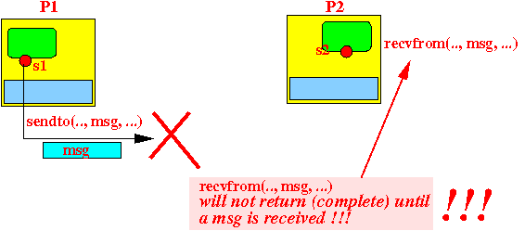
Sendto and Recivefrom function used in UDP

Slide 4
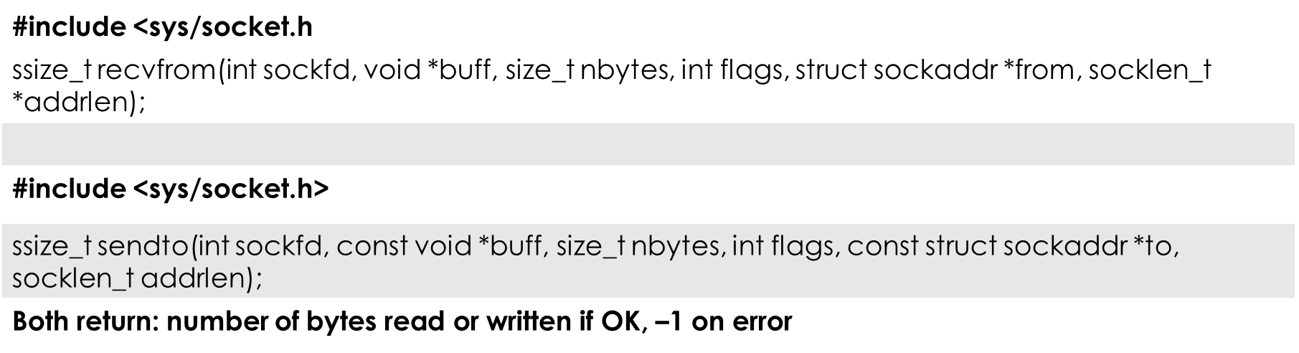
Sendto and Recivefrom functions used in UDP

Slide 5
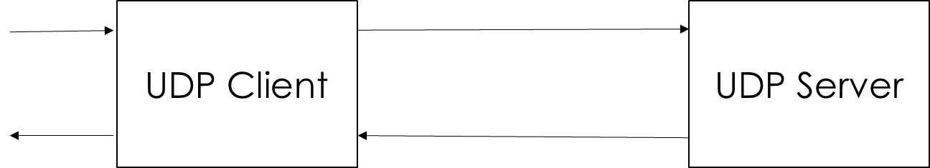
UDP Echo… Server, Client main
stdin fgets sendto recvfrom
stdout fputs recvfrom sendto

Slide 6
UDP echo Server
#include "unp.h"
int main(int argc, char **argv) {
int sockfd;
struct sockaddr_in servaddr, cliaddr;
sockfd = socket(AF_INET, SOCK_DGRAM, 0);
bzero(&servaddr, sizeof(servaddr));
servaddr.sin_family = AF_INET;
servaddr.sin_addr.s_addr = htonl(INADDR_ANY);
servaddr.sin_port = htons(SERV_PORT);
Bind(sockfd, (SA *) &servaddr, sizeof(servaddr));
dg_echo(sockfd, (SA *) &cliaddr, sizeof(cliaddr)); }

Slide 7
UDP Echo Server: 'dg_echo' Function
#include "unp.h"
void
dg_echo(int sockfd, SA *pcliaddr, socklen_t clilen) {
int n;
socklen_t len;
char mesg[MAXLINE];
for ( ; ; ) {
len = clilen;
n = Recvfrom(sockfd, mesg, MAXLINE, 0, pcliaddr, &len);
Sendto(sockfd, mesg, n, 0, pcliaddr, len);
}
}

Slide 8
UDP Echo Client: 'main' Function
#include "unp.h"
Int main(int argc, char **argv) {
int sockfd;
struct sockaddr_in servaddr;
If (argc != 2)
err_quit("usage: udpcli <IPaddress>");
bzero(&servaddr, sizeof(servaddr));
servaddr.sin_family = AF_INET;
servaddr.sin_port = htons(SERV_PORT);
Inet_pton(AF_INET, argv[1], &servaddr.sin_addr);
sockfd = Socket(AF_INET, SOCK_DGRAM, 0);
dg_cli(stdin, sockfd, (SA *) &servaddr, sizeof(servaddr));
exit(0); }

Slide 9
UDP Echo Client: 'dg_cli' Function
#include "unp.h"
void dg_cli(FILE *fp, int sockfd, const SA *pservaddr, socklen_t servlen) {
int n;
char sendline[MAXLINE], recvline[MAXLINE + 1];
while (Fgets(sendline, MAXLINE, fp) != NULL) {
Sendto(sockfd, sendline, strlen(sendline), 0, pservaddr, servlen);
n = Recvfrom(sockfd, recvline, MAXLINE, 0, NULL, NULL);
recvline[n] = 0; /* null terminate */
fputs(recvline, stdout);
}
}

Slide 10
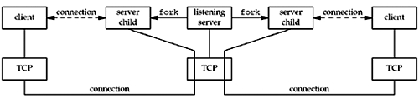
TCP client/server with two clients.

Slide 11
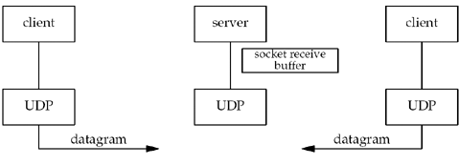
UDP client/server with two clients

Slide 12
Lost Datagrams
If the client datagram arrives at the server but server’s reply is lost, the client will
again block forever in its call to recvfrom.
The only way to prevent this is to place a timeout on the recvfrom.

Slide 13
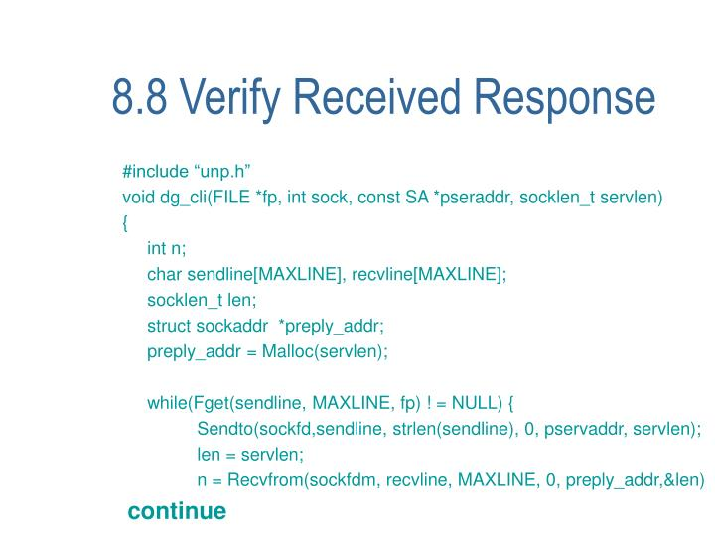
Verifying received responses

Slide 14
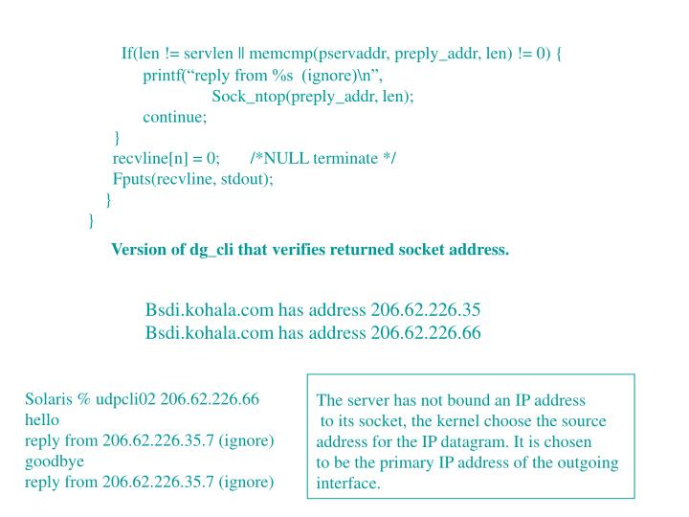
Verifying received responses

Slide 15
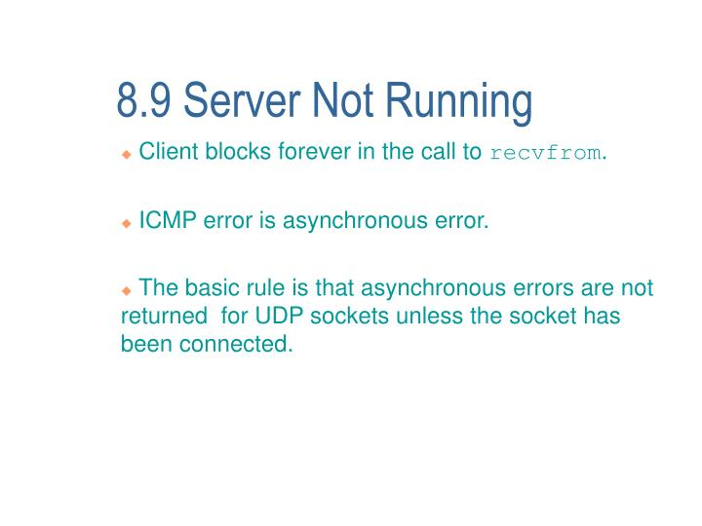
Server Not Running

Slide 16
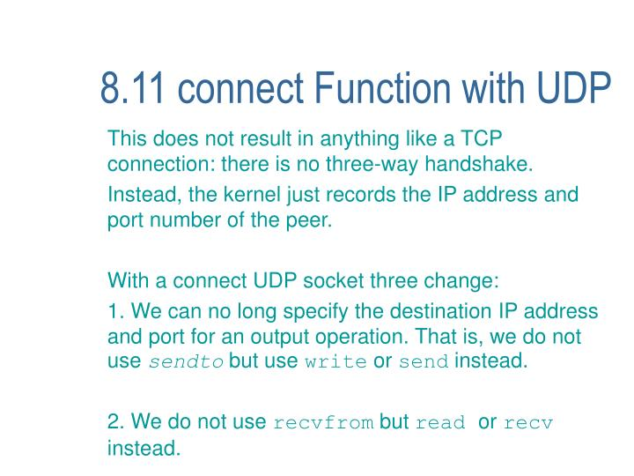
Connect Function with UDP

Slide 17
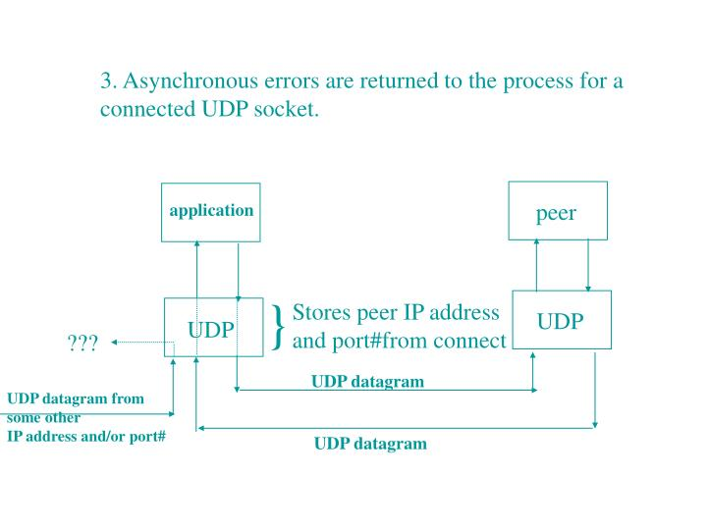
Connect Function with UDP

Slide 18
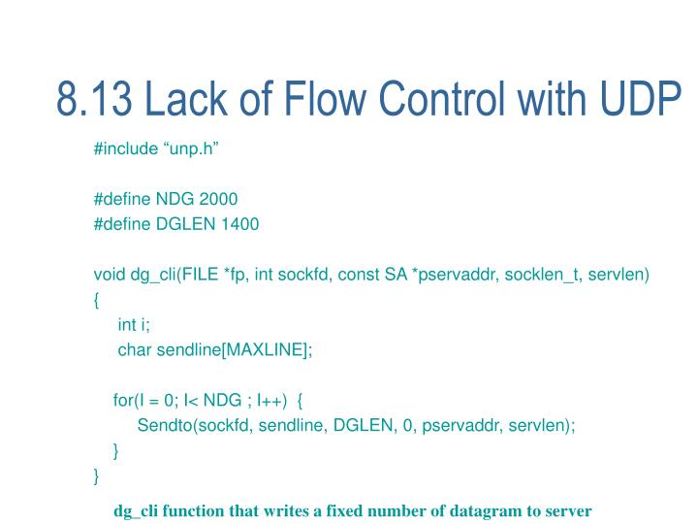
Lack of flow control with UDP

Slide 19
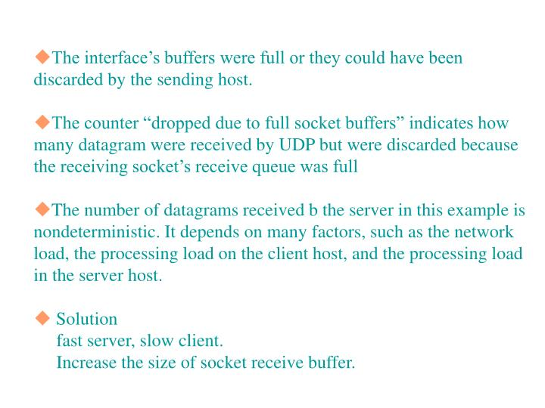
Lack of flow control with UDP

Slide 20
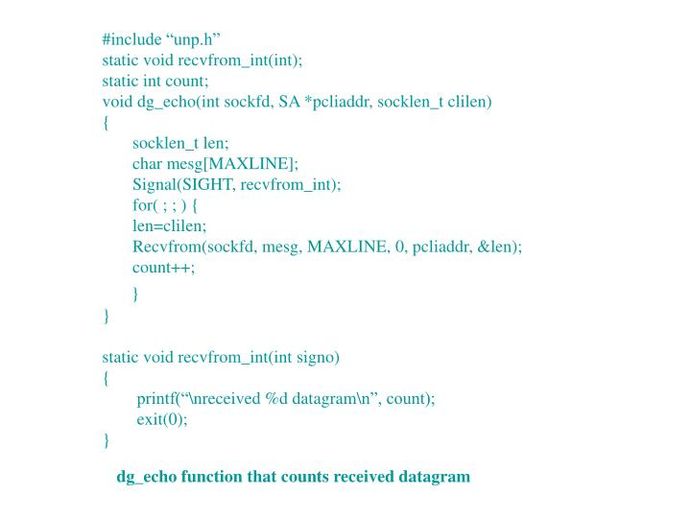
Lack of flow control with UDP

Slide 21
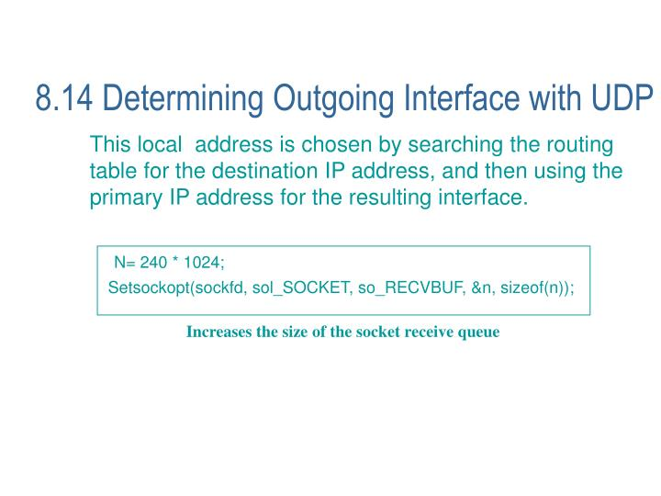
Determining outgoing interface with UDP

Slide 22
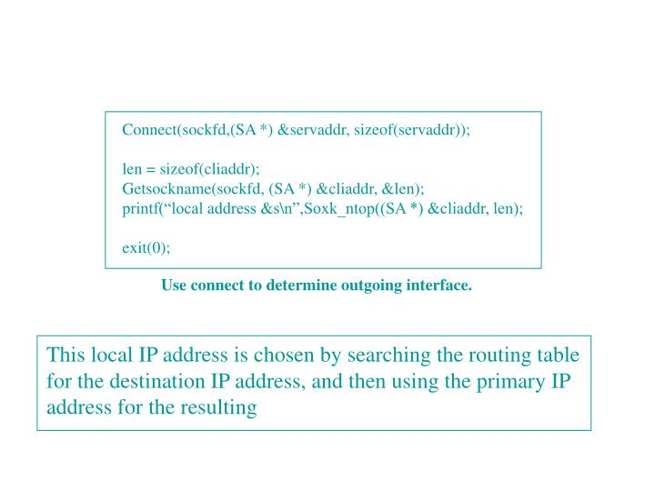
Determining outgoing interface with UDP

Slide 23
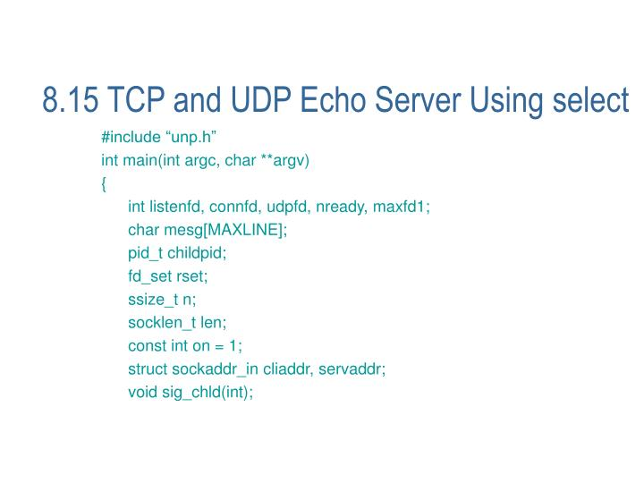
TCP and UDP Echo server with select

Slide 24
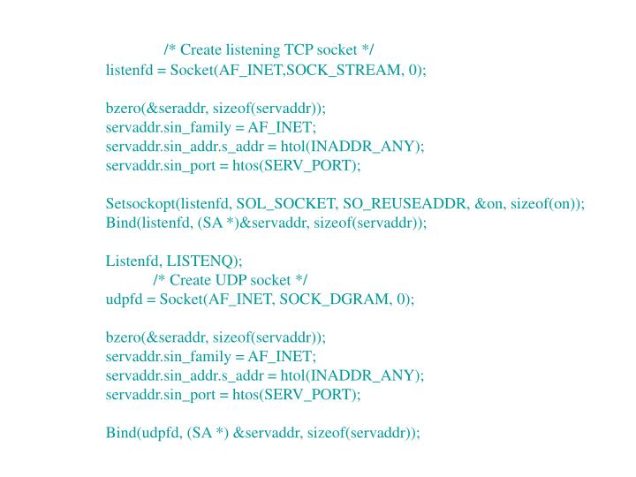
TCP and UDP Echo server with select

Slide 25
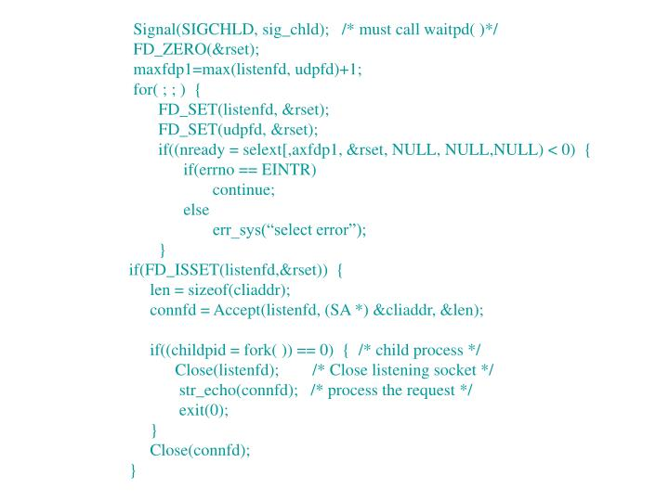
TCP and UDP Echo server with select

Slide 26
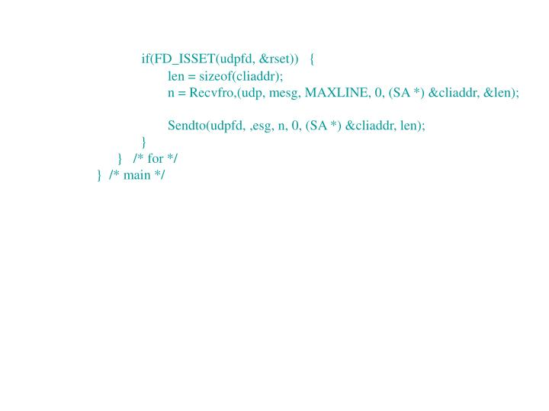

Slide 27
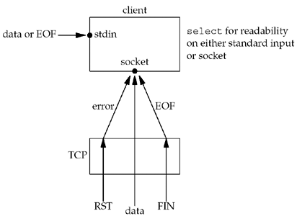

Slide 28
Server
UDP Socket TCP Socket
readfrom ….
SELECT
FD_SET
1
1
0
0
1
0
STDIN

Slide 29
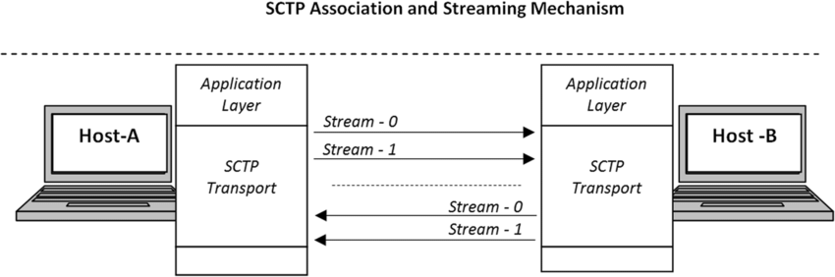

Slide 30
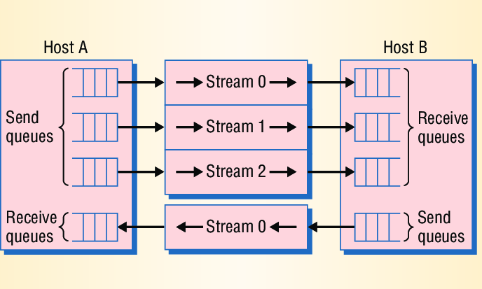

Slide 31
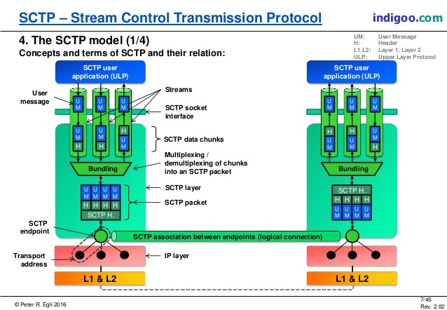

Slide 32
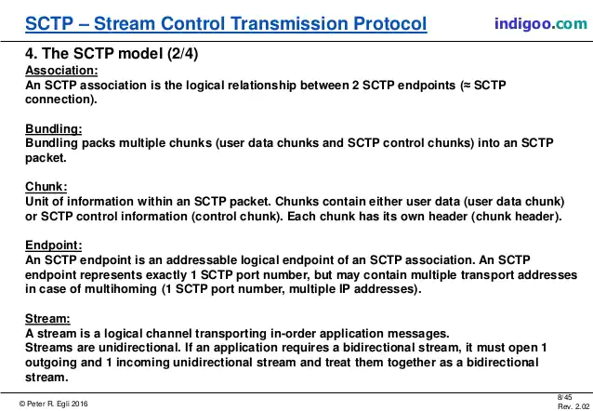

Slide 33
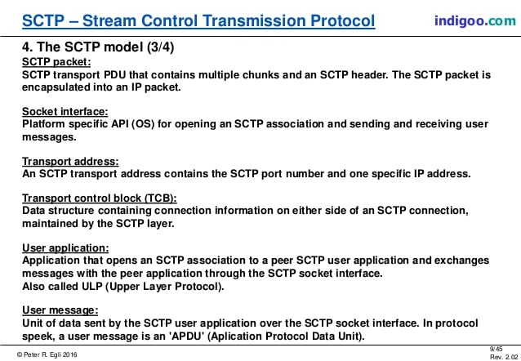

Slide 34
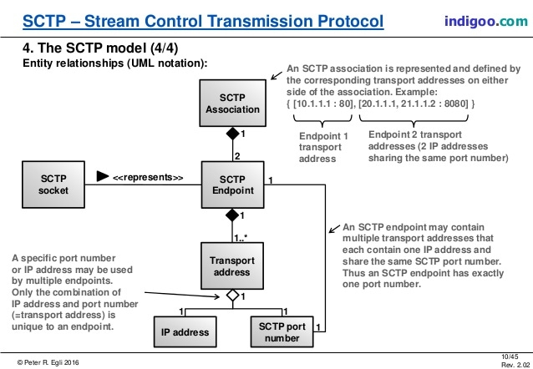

Slide 35
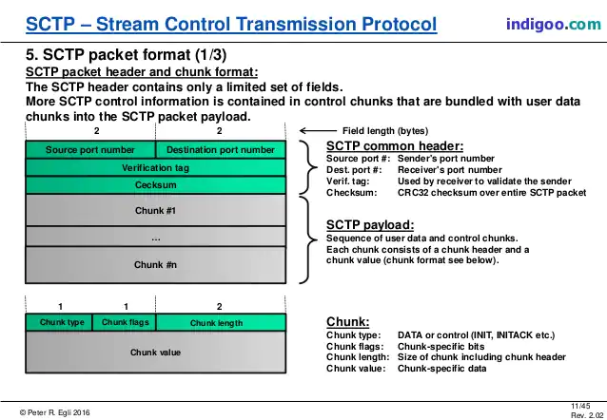

Slide 36
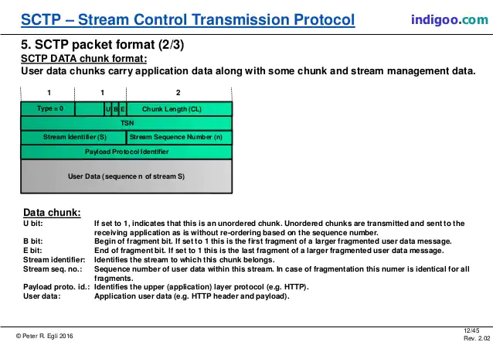

Slide 37
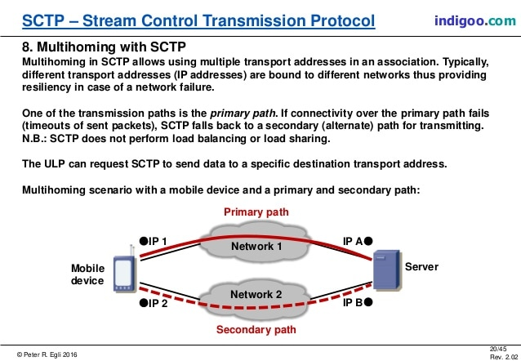

Slide 38
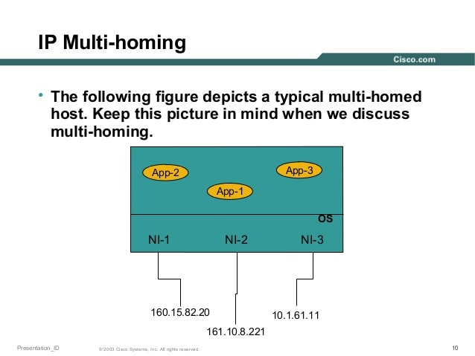

Slide 39
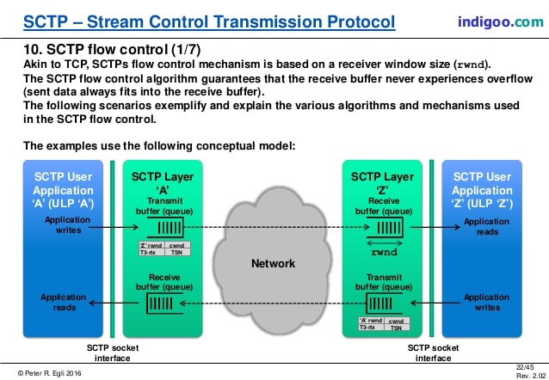

Slide 40
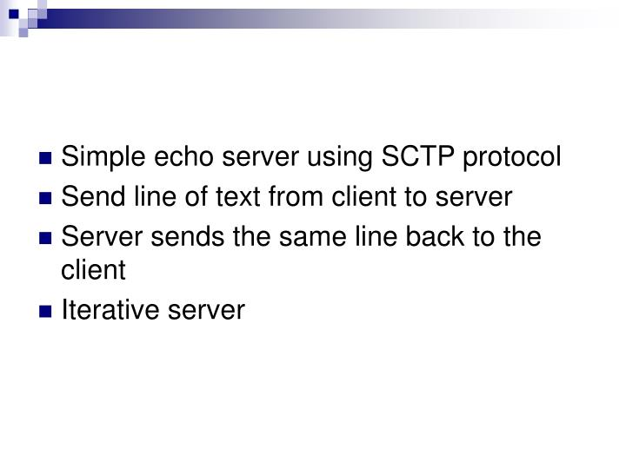

Slide 41
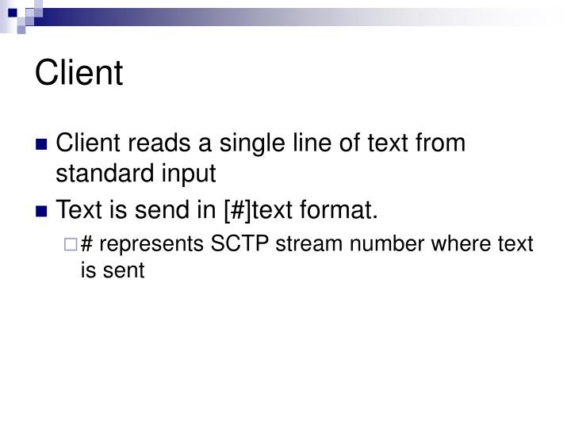

Slide 42
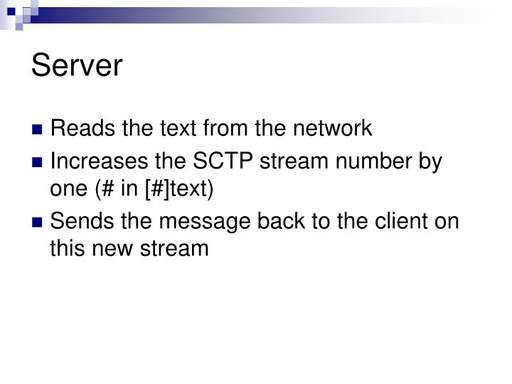

Slide 43
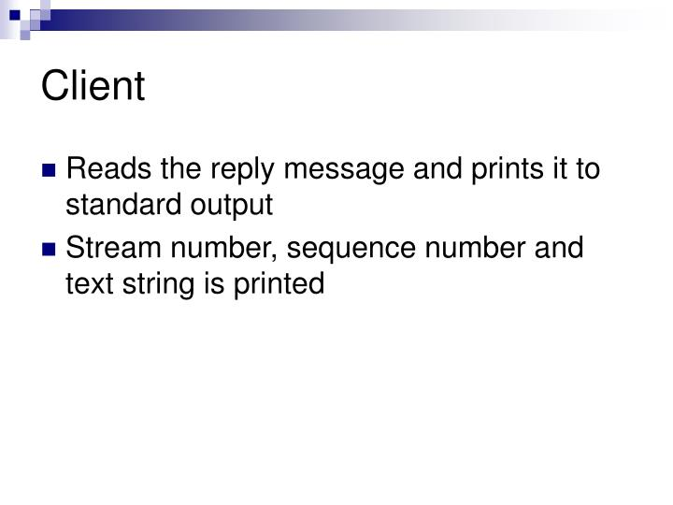

Slide 44
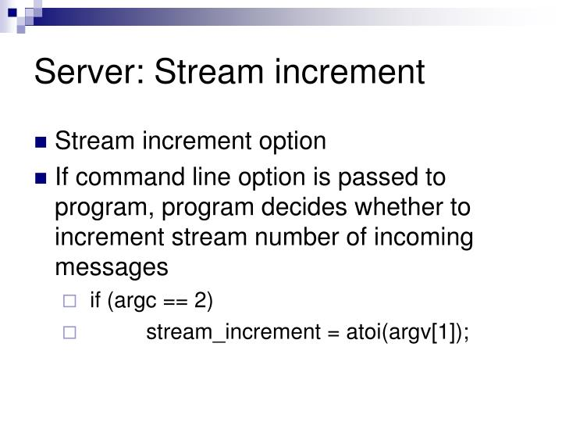

Slide 45
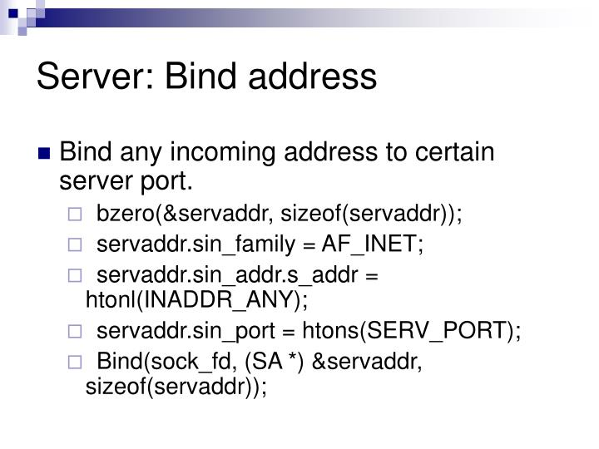

Slide 46
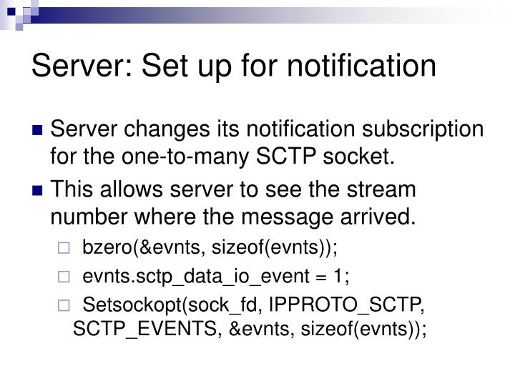

Slide 47
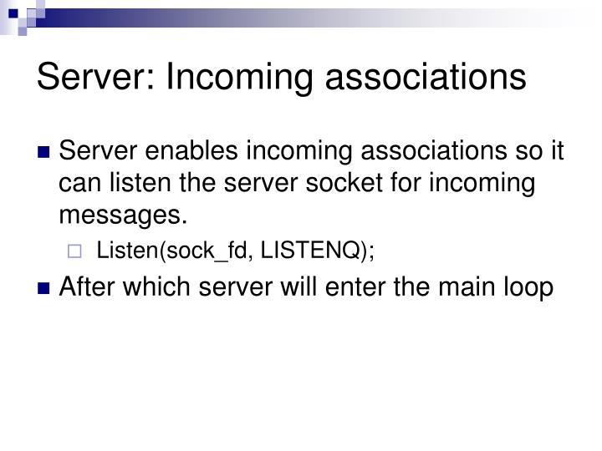

Slide 50
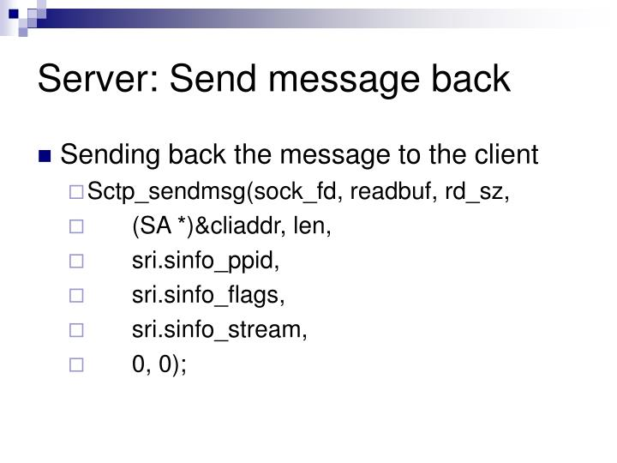

Slide 51
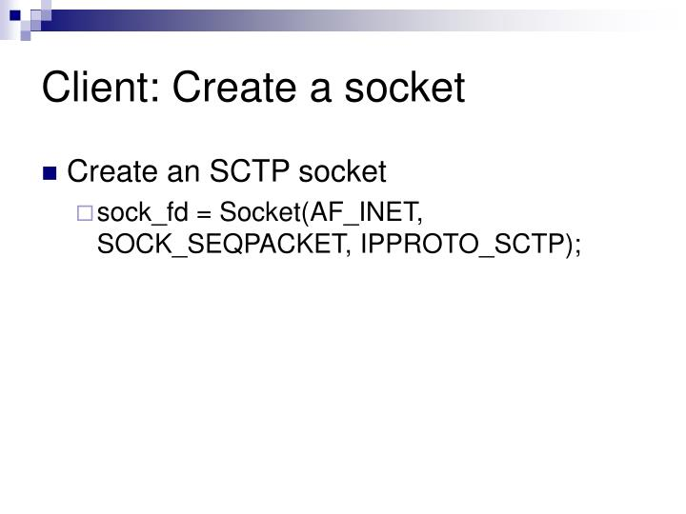

Slide 52
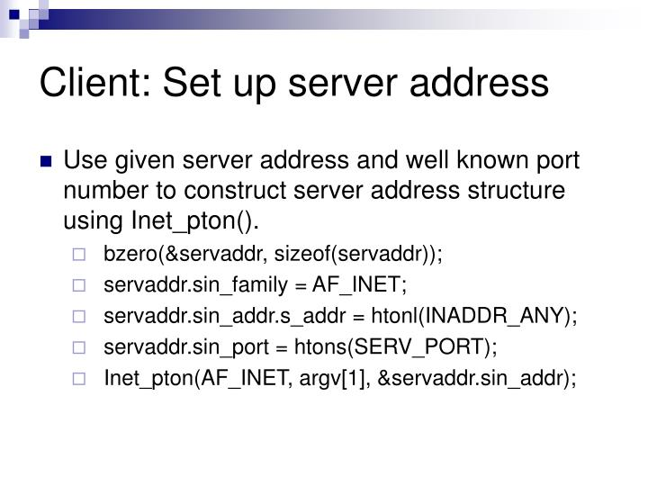

Slide 54
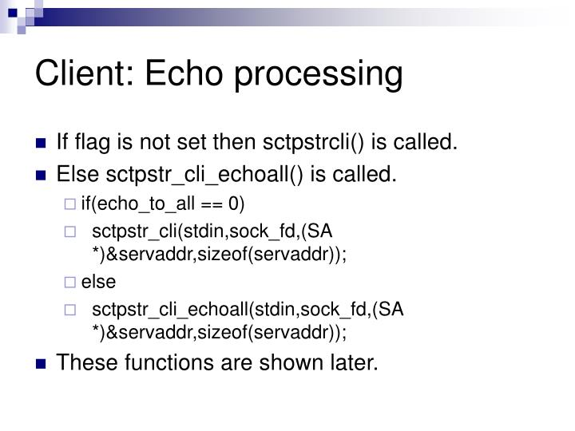

Slide 55
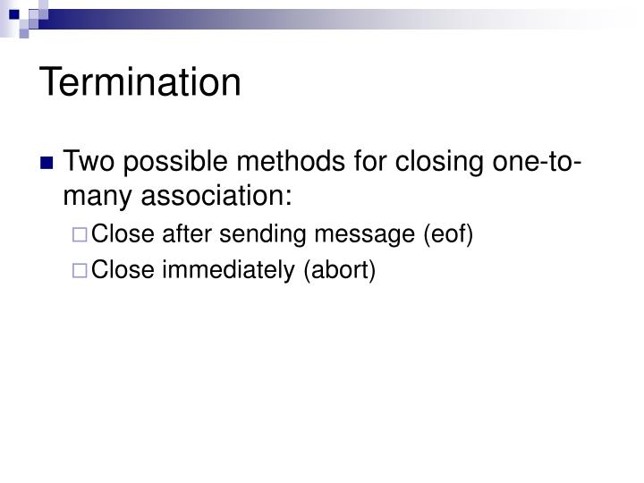

Slide 56
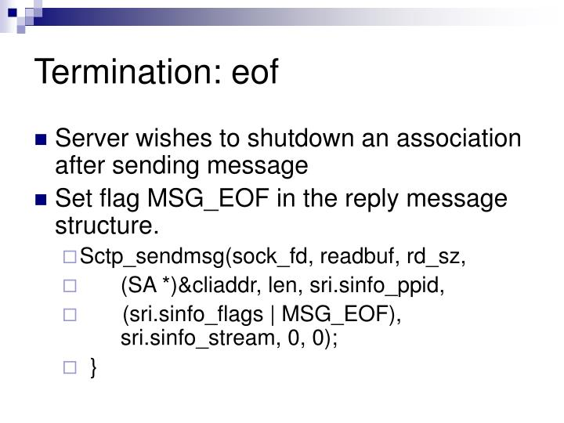

Slide 57
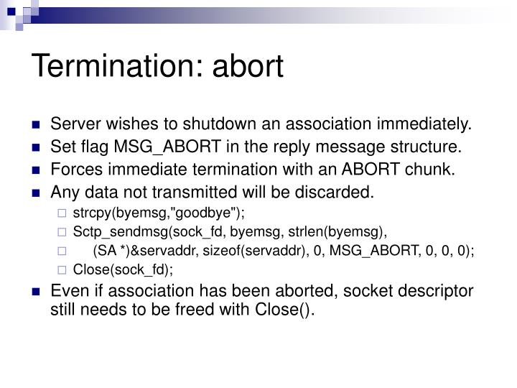

Slide 58
Interface Models
There are 2 types of SCTP sockets
One to One: A one-to-one socket corresponds to exactly one SCTP association – similar to TCP
One to Many: In one-to-many, several SCTP associations can be active on a given socket simultaneously. – similar to UDP.
The choice of the socket type depends on
What type of server is being written, iterative or concurrent?
How many socket descriptors does the server wish to manage?
Is it important to optimize the association setup to enable data on the third (and possibly fourth) packet of the four-way handshake?
How much connection state does the application wish to maintain?

Slide 59
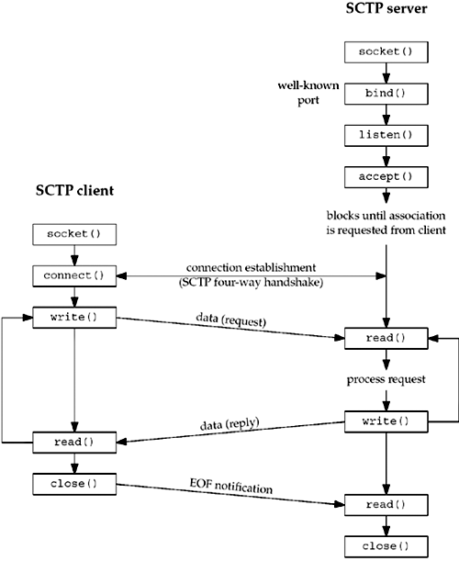
One-to-One Model
When the server is started, it opens a socket, binds to an address, and waits for a client connection with the accept system call. Sometime later, the client is started, it opens a socket, and initiates an association with the server. We assume the client sends a request to the server, the server processes the request, and the server sends back a reply to the client. This cycle continues until the client initiates a shutdown of the association. This action closes the association, whereupon the server either exits or waits for a new association.
A one-to-one-style SCTP socket is an IP socket (family AF_INET or AF_INET6), with type SOCK_STREAM, protocol IPPROTO_SCTP.

Slide 60
Key Differences from TCP model
The one-to-one style was developed to ease the porting of existing TCP applications to SCTP.
Any socket options must be converted to the SCTP equivalent. Two commonly found options are TCP_NODELAY and TCP_MAXSEG.
SCTP preserves message boundaries; thus, application-layer message boundaries are not required.
Some TCP applications use a half-close to signal the end of input to the other side. To port such applications to SCTP, the application-layer protocol will need to be rewritten so that the application signals the end of input in the application data stream.
The send function can be used in the normal fashion

Slide 61
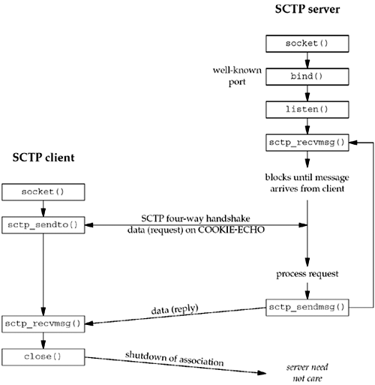
One-to-Many Model
First, the server is started, creates a socket, binds to an address, calls listen to enable client associations, and calls sctp_recvmsg, which blocks waiting for the first message to
arrive. A client opens a socket and calls sctp_sendto, which implicitly sets up the
association and piggybacks the data request to the server on the third packet of the
four-way handshake. The server receives the request, and processes and sends back
a reply. The client receives the reply and closes the socket, thus closing the
association. The server loops back to receive the next message.

